Slide 1





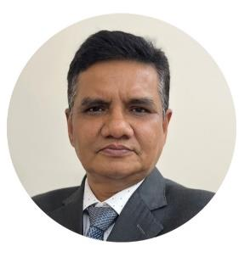
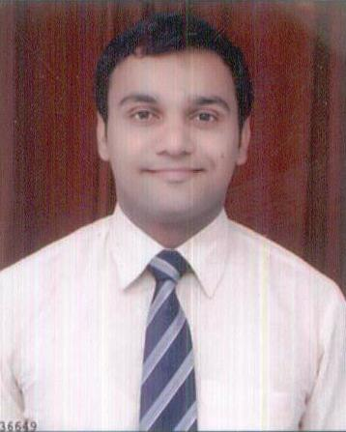
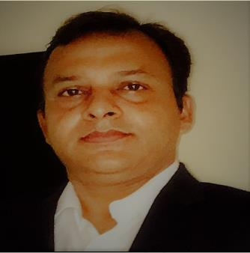
INVITES FOR
WIIFM(What’s In It For Me?)
3-DAY BOOT CAMP
UNLOCK YOUR CAREER POTENTIAL!
NIGERIA-INDIA COLLABORATION
Attend Boot Camp and qualify for ‘TALENTED 30’- Learn Now Pay Later Program launching soon
📅 Dates: December 18–20, 2024
📍 Venue: Online via Zoom | offline: Basco Plaza, Boshorun, Ibadan
👥 Open to:
Working Professionals | University Students | NYSC Corps Members
Entrepreneurs
Fee: N20000 per participant
Meet Our Industry Experts
Why Attend?
Join this boot camp to explore four of the most in-demand
career fields, guided by international industry experts.
Gain insights into how these disciplines are shaping industries,
driving innovation and creating endless job opportunities globally.
Mr. Anand Jha
Project Management
Expert
Ms. Eno Eka
Business Analyst
Mr. Vaibhav Bhatnagar
Cyber Security
Mr. Anup Kumar
Data Scientist
Learn With Us
Latest platforms and statistical tools
used in industries
Click To Register Now
https://forms.gle/9LVaEQ5tAxhgb2nz8
Acc Name: HSProjects Technologies
Acc No: 1228405736
Bank name: Zenith Bank
Pay Online To

Slide 2
Why Attend?
Join this boot camp to explore four of the most in-demand
career fields, guided by international industry experts.
Gain insights into how these disciplines are shaping industries,
driving innovation and creating endless job opportunities globally.
Hands-on-experience with popular applications and case studies
Conquer the concept of WIIFM (What’s In It For Me?)
NIGERIA-INDIA COLLABORATION
Who should attend?
Working professionals from field of BFSI (Banking , Financial Services and Insurance), Logistics & Supply Chain, Healthcare, Telecom, Research, Entrepreneurs, Business School Students, Freelancers
Pedagogy
Live classes with choices of online, offline and hybrid participation
Conceptual learning with hands-on-practice
Facilitation by international industry experts as coach and guest speakers
How to register?
Click the registration link
Fill in your personal and professional details
Pay online with given bank details. No cash will be accepted

Slide 3


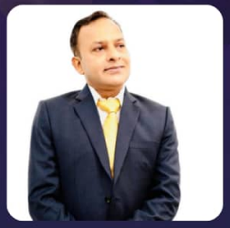
MEET OUR FACILITATORS AND GUEST SPEAKERS
“Eno Eka is the founder of the Business Analysis School and change manager based in Calgary., Alberta. She is an award-winning career coach and speaker who has been recognized for helping more than 20000 professionals around the world kickstart their professional careers.”
“Vaibhav is a highly skilled Cyber Security professional with extensive experience in network engineering and technical support. He is proficient in securing IT infrastructures, implementing advanced security protocols and managing risk assessments to safeguard systems from cyber threats.”
Eno Eka
CEO & Founder of the Business Analysis School
Vaibhav Bhatnagar
Cyber Security Expert
“Anand is a highly qualified professional, holding degrees in mechanical engineering and management, complemented by certifications in BB-MB in Six Sigma and project management. Anand excels in offering strategic guidance, shaping organizational structures and providing visionary leadership to elevate business excellence within the manufacturing and service sectors.”
“Anup is an expert in Business Analytics with 22 years of experience in banking, telecom, contact centers, supply chain, logistics, ecommerce and education space. He is also an expert in applying Six Sigma, machine learning, Artificial Intelligence, PDCA and ISO 9001. Possesses excellent understanding of work culture, customer needs, in markets of Africa and India.”
Anand Jha
Project Management Expert
Anup Kumar
Data Scientist & Business Excellence Expert

Slide 4
What You’ll Gain From This Bootcamp:
Data Analytics
Benefits in Industries: Used for decision-making, market trends analysis, and improving business efficiency across industries such as BFSI, healthcare, retail, ecommerce and technology.
Job Scope in International Markets: Data Analyst, Data Scientist, Business Intelligence Analyst, and more.
Applications: Statistical Analysis With Tools like Excel, Tableau, Power BI, Python, and SQL.
Project Management
Benefits in Industries: Ensures project goals are achieved efficiently, saving time and resources in fields like IT,
construction, marketing, and engineering.
2. Job Scope in International Markets: Project Manager, Scrum Master, Program Manager, and PMO roles.
3. Applications: Tools like Jira, Trello, Microsoft Project, and Agile methodologies.
Key Features:
Expert-Led Sessions: Learn from international industry leaders with hands-on experience.
Networking Opportunities: Connect with professionals and peers from diverse fields.
Certification: Receive a certificate of participation to boost your career profile.
Career Guidance: Insights into international job markets and growth paths.
3. Business Analysis
Benefits in Industries: Bridges the gap between business needs and technical solutions, optimizing business performance.
Essential in sectors like banking, IT, and consultancy.
2. Job Scope in International Markets: Business Analyst, Systems Analyst, Product Owner, and Consultant.
3. Applications: Tools like Visio, Lucidchart, Jira, and business process modeling tools.
4. Cyber Security
Benefits in Industries: Protects organizations from data breaches, hacking, and cyber threats. Critical in finance,
healthcare, e-commerce, and government sectors.
Job Scope in International Markets: Cybersecurity Analyst, Ethical Hacker, IT Security Consultant, and SOC Analyst.
Applications: Tools like Wireshark, Splunk, Nessus, and SIEM systems.
Program Schedule
COURSE | DATE | TIME
DATA ANALYTICS | DEC 18-20 | 10AM TO 1PM
PROJECT MGT | DEC 18-20 | 2PM TO 5PM
BUSINESS ANALYSIS | DEC 18-20 | 10AM TO 1PM
CYBER SECURITY | DEC 18-20 | 2PM TO 5PM

Slide 5
Program Schedule & Itinerary
COURSE | DATE | TIME
DATA ANALYTICS | DEC 18-20 | 10AM TO 1PM
PROJECT MGT | DEC 18-20 | 2PM TO 5PM
BUSINESS ANALYSIS | DEC 18-20 | 10AM TO 1PM
CYBER SECURITY | DEC 18-20 | 2PM TO 5PM
PROGRAMS | DAY 1 (WIIFM) | DAY 2 (Basic but Powerful) | DAY 3 (Be a Contributor, not a Subscriber)
DATA ANALYTICS | Introduction and exposure to industry terms- Big Data, Machine Learning, Data Science vs Data Analysis, AI, Business Analysis vs Analytics Introduction & application of Python & Power BI and their combined benefits | Basic Statistics, related tools and their power at your desk Hypothesis Testing Linear Regression in 30 Minutes | Logistic regression as a classification algorithm at your desk Exposure to 9 popular machine learning algorithms for best business solution in your role AI world using Deep Learning in 30 minutes
PROJECT MANAGEMENT | what project management is and what a project manager does, common organizational structures and how they impact project management how to apply your skills from previous work experience to project management roles and types of project management roles | The project management and life cycle methodologies | Common organization structure and impact on project management. Your contribution in a project in your role

Slide 6
Program Schedule & Itinerary
PROGRAMS | DAY 1 (WIIFM) | DAY 2 (Basic but Powerful) | DAY 3 (Be a Contributor, not a Subscriber)
BUSINESS ANALYSIS | What is a Business Process? Business Process Characteristics SDLC Overview SDLC Variance | Role of the Business Analyst Change Management & Organizational Readiness Project Plan Data flow diagrams | Object Orientation (OO) Introduction Inheritance and Unified Modelling Language (UML) Additional Diagrams Acquisition Strategies Alternative Analysis Architectural Options
CYBER SECURITY | Cyber Security insights -learn about critical thinking, its significance, and how it applies in real-world scenarios within cybersecurity. gain a clear understanding of the five key elements of the critical thinking model. five critical thinking skills that help form the foundation in every professional field, including cybersecurity. | Cyber Security Controls -Learn about a range of internet security threats, including network mapping, packet sniffing, ID spoofing, denial-of-service (DoS) attacks, and injection attacks. gain insights into system, network, and application security. delve into vulnerability assessment, incident response, and digital forensics. | Identity & physical controls -learn about identity and access management (IAM) and its four main categories. -explore various authentication protocols and methods to verify an individual's identity gain a clear understanding of different access control schemes.

